Slide 1
T-test

Slide 2
Outline
What is a T-test
When to use a T-test?
Types of T-test
One sample T-test
Independent samples T-test
Paired sample t-test
Hypotheses and Assumptions
How a T-test is calculated

Slide 3
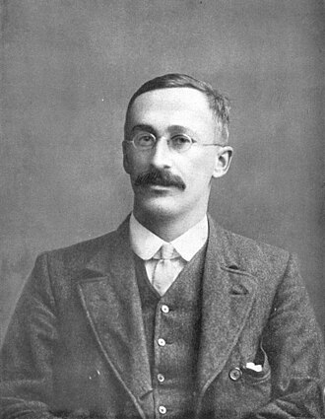
What is a T-test
The T-test is a statistical test procedure that tells you how significant the differences between group means are.
It lets you know if those differences in means could have happened by chance.

Slide 4



Slide 5
The T-test analyzes if there is a significant difference between the means of two groups

Slide 6
The T-test analyzes if there is a significant difference between the means of two groups

Slide 7
The T-test analyzes if there is a significant difference between the means of two groups

Slide 8


For example, two groups would be patients who received Drug A and Drug B

Slide 9
We would like to know if there is a difference between blood pressure between these two groups

Slide 10
We would like to know if there is a difference between blood pressure between these two groups

Slide 11
We would like to know if there is a difference between blood pressure between these two groups

Slide 12
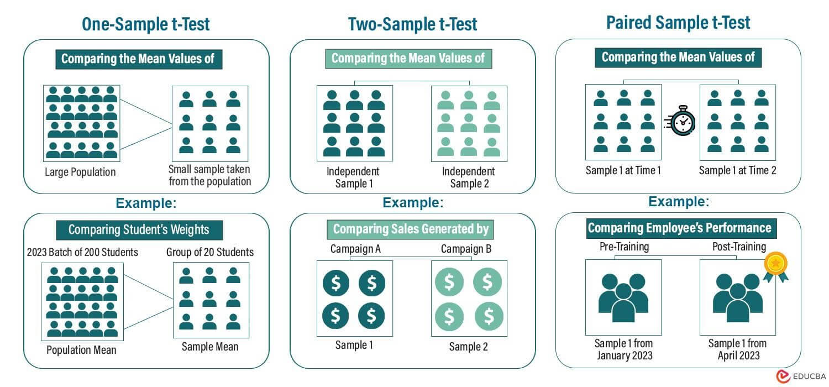
Types of T-test

Slide 17

One sample T-test
Sample Mean
Known mean value (Reference Mean)
We use a one sample T-test when we want to compare a sample mean with a known reference mean

Slide 18

One sample T-test
10 ml
Buy now!
For example, a company that sells a perfume claims that their bottles contain 10 ml of liquid.

Slide 19
One sample T-test
10 ml
Buy now!
To check this we buy 30 samples of perfume and measure them.

Slide 20
One sample T-test
10 ml
Buy now!
8 ml
The mean value of this sample is 8 ml

Slide 21
One sample T-test
10 ml
Buy now!
8 ml
Now we can use a one sample T-test to check if the sample mean of 8 ml is significally different from the claimed 10 ml

Slide 22
Independent (Two) samples T-test
We use the independent samples T-test when we want to compare a means of two independent groups or samples

Slide 23
Independent (Two) samples T-test
We want to know if there is a significant difference between these means.

Slide 24
Independent (Two) samples T-test
We want to know if there is a significant difference between these means.

Slide 25
Independent (Two) samples T-test
We want to know if there is a significant difference between these means.

Slide 26
Independent (Two) samples T-test
Drug A
Drug B
For example, we want to compare the effectiveness of two drugs

Slide 27
Independent (Two) samples T-test
First we randomly divide a group of 30 people into two groups

Slide 28
Independent (Two) samples T-test
The first group receives Drug A and the second group receives Drug B

Slide 29
Independent (Two) samples T-test
Using an independent T-test, we can now test if there is a significant difference in pain-relief between the two groups

Slide 30


Paired samples T-test
We use the paired samples T-test to compare the means of two dependent groups

Slide 31
Paired samples T-test
For example, we want to know how effective a muscle building program is.

Slide 32
Paired samples T-test
Before: 300 lbs
After: 150 lbs
Before: 250 lbs
After: 200 lbs
Before: 400 lbs
After: 250 lbs
To do this we weigh 30 people before the program

Slide 33
Paired samples T-test
Before: 300 lbs
After: 150 lbs
Before: 250 lbs
After: 200 lbs
Before: 400 lbs
After: 250 lbs
And weigh the same 30 people after the program.

Slide 34
Paired samples T-test
Lost 150 lbs
Before: 300 lbs
After: 150 lbs
Lost 50 lbs
Before: 250 lbs
After: 200 lbs
Lost 150 lbs
Before: 400 lbs
After: 250 lbs
Now we can look at the difference in weight between before and after for each subject.

Slide 35
Paired samples T-test
Lost 150 lbs
Before: 300 lbs
After: 150 lbs
Lost 50 lbs
Before: 250 lbs
After: 200 lbs
Lost 150 lbs
Before: 400 lbs
After: 250 lbs
We can now use a paired samples T-test to test if there is a significant difference

Slide 36
Assumptions of a T-test
In a one sample T-test, we need a sample and a reference value

Slide 37
Assumptions of a T-test
In an Independent samples T-test, we need two independent samples.

Slide 38
Assumptions of a T-test
In a paired sample T-test, we need a paired sample

Slide 39
Assumptions of a T-test
Second, the variable for which we want to test whether there is a difference between the means must be metric (e.g. Age, Weight, Income)

Slide 40
Assumptions of a T-test
In addition, the metric variable must be normally distributed.

Slide 41
Assumptions of a T-test
Lastly, for independent samples T-test, the variances in the two groups must be approximately equal.

Slide 42
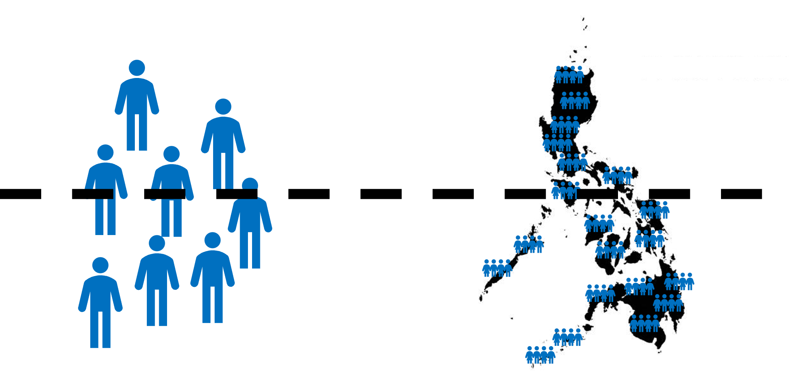
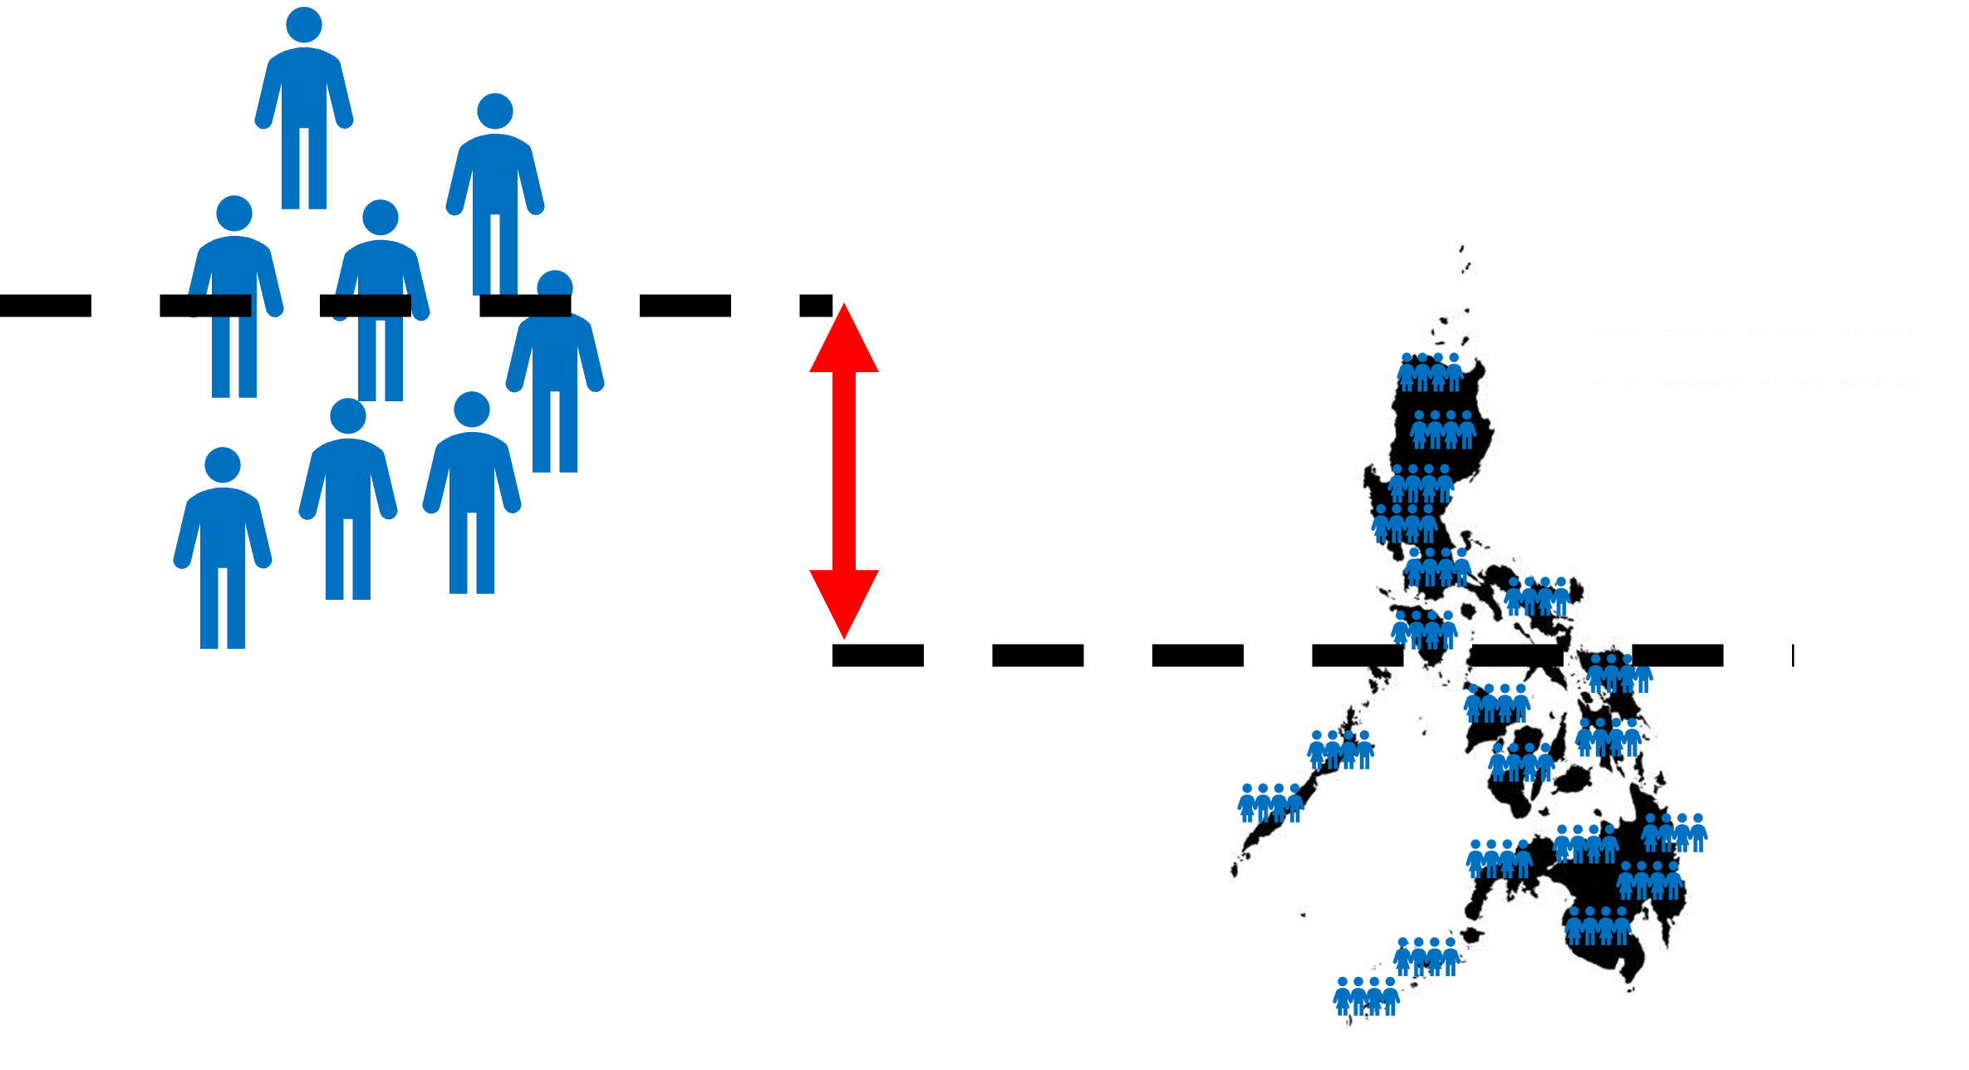
Hypotheses of a One Sample T-test
Null Hypothesis:
Alternative Hypothesis:
The sample mean is
equal to the reference value
The sample mean is
unequal to the reference value

Slide 43
Hypotheses of a Independent Samples T-test
Null Hypothesis:
Alternative Hypothesis:
The means values in both
groups are the same.
The means values in both
groups are not equal.

Slide 44
Hypotheses of a Paired Samples T-test
Null Hypothesis:
Alternative Hypothesis:
The mean of the difference between the pairs is zero
The mean of the difference between the pairs is not zero

Slide 45


T-test Example
Inference Question:
“Is there a statistically significant difference in mean exam scores between the two teachers’ classes?”

Slide 46
Student | Score
A | 78
B | 85
C | 88
D | 90
E | 72
F | 84
G | 91
H | 87
I | 79
J | 83
K | 86
L | 89
M | 75
N | 92
O | 81
Student | Score
A | 70
B | 74
C | 69
D | 76
E | 72
F | 68
G | 71
H | 75
I | 73
J | 77
K | 74
L | 70
M | 72
N | 69
O | 71

Slide 47
Step 1: Choose the appropriate test
Inference Question:
“Is there a statistically significant difference in mean exam scores between the two teachers’ classes?”
Because we are comparing the means of two groups, the appropriate test is the independent samples T-test

Slide 48


Step 2: State the Hypotheses
Null hypothesis ($H₀$):
The mean exam scores of both classes are equal
$$u_{1}=u_{2}$$
Alternative hypothesis ($H₁$):
The mean exam scores of both classes are not equal
$$u_{1}≠u_{2}$$

Slide 49
Step 3: Compute the means
Student | Score
A | 78
B | 85
C | 88
D | 90
E | 72
F | 84
G | 91
H | 87
I | 79
J | 83
K | 86
L | 89
M | 75
N | 92
O | 81
Student | Score
A | 70
B | 74
C | 69
D | 76
E | 72
F | 68
G | 71
H | 75
I | 73
J | 77
K | 74
L | 70
M | 72
N | 69
O | 71

Slide 50

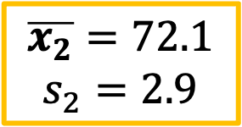
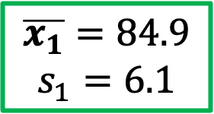
Student | Score
A | 78
B | 85
C | 88
D | 90
E | 72
F | 84
G | 91
H | 87
I | 79
J | 83
K | 86
L | 89
M | 75
N | 92
O | 81
Student | Score
A | 70
B | 74
C | 69
D | 76
E | 72
F | 68
G | 71
H | 75
I | 73
J | 77
K | 74
L | 70
M | 72
N | 69
O | 71
$\overline{x_{1}}=84.9$
$$s_{1}=6.1$$
$\overline{x_{2}}=72.1$
$$s_{2}=2.9$$
$$\overline{x_{1}}−\overline{x_{2}}=12.8$$

Slide 51
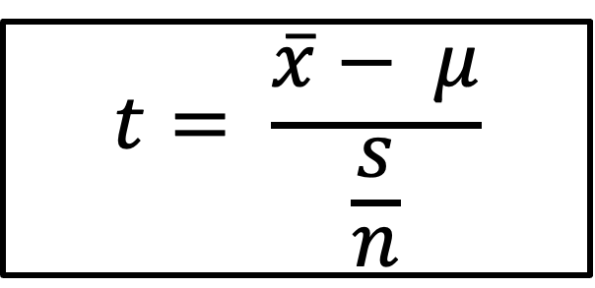
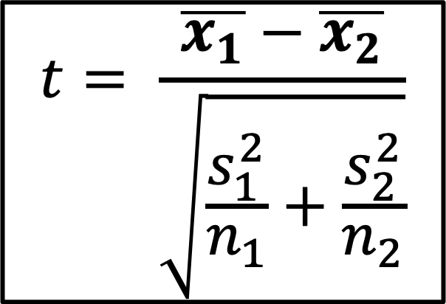
Step 4: Compute T-test score
One Sample T-test
Independent Sample T-test
$$t= \frac{\overline{x}− μ}{\frac{s}{n}}$$
$$t= \frac{\overline{x_{1}}−\overline{x_{2}}}{\sqrt{\frac{s_{1}^{2}}{n_{1}}+\frac{s_{2}^{2}}{n_{2}}}}$$

Slide 52
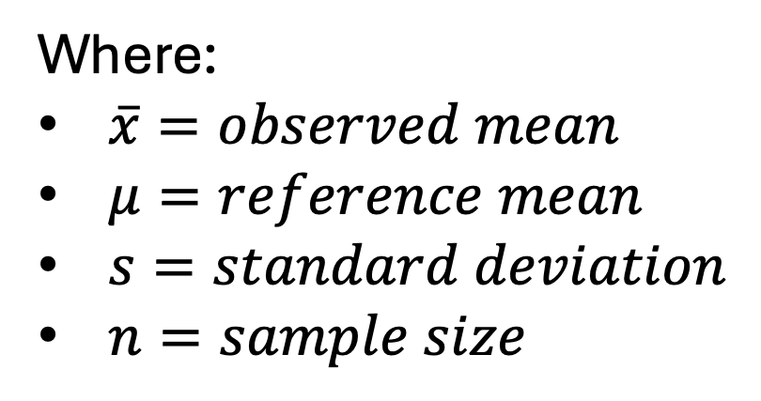
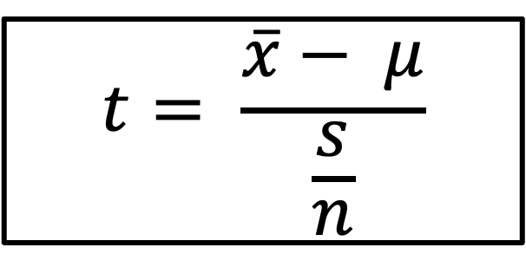
Step 4: Compute T-test score
One Sample T-test
$$t= \frac{\overline{x}− μ}{\frac{s}{n}}$$
Where:
$\overline{x}=observed mean$
$μ=reference mean$
$s=standard deviation$
$n=sample size$

Slide 53
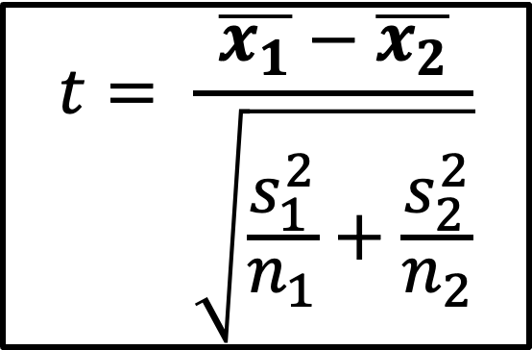
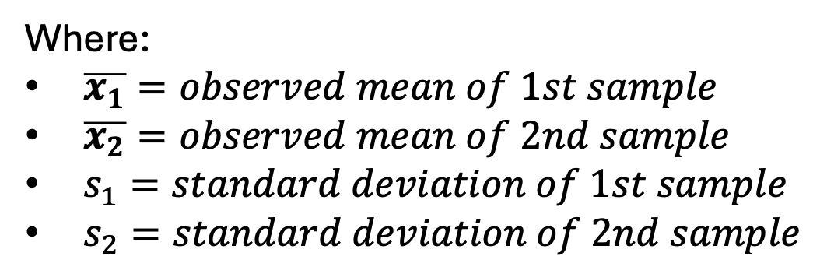
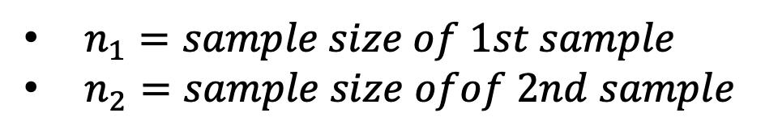
Step 4: Compute T-test score
Independent Sample T-test
$$t= \frac{\overline{x_{1}}−\overline{x_{2}}}{\sqrt{\frac{s_{1}^{2}}{n_{1}}+\frac{s_{2}^{2}}{n_{2}}}}$$
Where:
$\overline{x_{1}}=observed mean of 1st sample$
$\overline{x_{2}}=observed mean of 2nd sample$
$s_{1}=standard deviation of 1st sample$
$s_{2}=standard deviation of 2nd sample$
$n_{1}=sample size of 1st sample$
$n_{2}=sample size ofof 2nd sample$

Slide 54
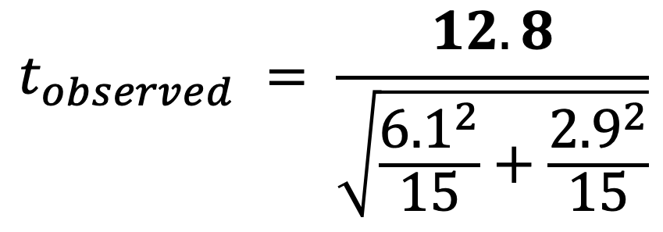
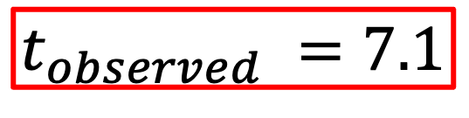
Step 4: Compute T-test score
Independent Sample T-test
$$t_{observed} = \frac{12.8}{\sqrt{\frac{{6.1}^{2}}{15}+\frac{{2.9}^{2}}{15}}}$$
$$t_{observed} =7.1$$

Slide 55
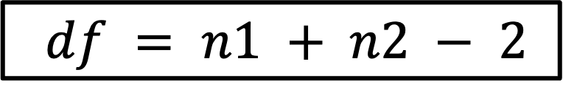

Step 5: Make a Decision
One-Sample t-test:
$$df = n − 1$$
(where n is sample size).
Independent Samples t-test:
$df = n1 + n2 − 2$
(where n1 and n2 are sample sizes
of two groups).

Slide 56

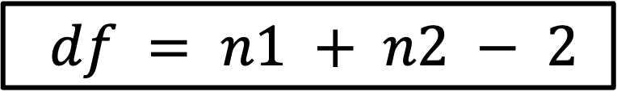
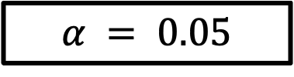
Step 5: Make a Decision
$df = n1 + n2 − 2$
$$df =15+15 −2=28$$
Choose a level of significance, let us choose
$$α = 0.05$$
If there were truly no difference between teachers, we are willing to be wrong 5% of the time due to random chance.
Critical t (α = 0.05, two-tailed) ≈ 2.06
Observed t ≈ 7.1
Decision:
∣t∣>tcritical⇒Reject H0∣t∣>tcritical​⇒Reject H0​

Slide 61



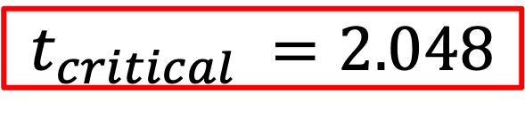
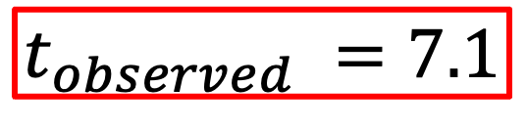
Step 5: Make a Decision
Reject $H₀$ the null Hypothesis if: $​$
$$if t_{observed}​ > t_{critical} ​$$
$$t_{observed} =7.1$$
$$t_{critical} =2.048$$
$$if 7.1​ >2.048 ​$$
Critical t (α = 0.05, two-tailed) ≈ 2.06
Observed t ≈ 7.1
Decision:
∣t∣>tcritical⇒Reject H0∣t∣>tcritical​⇒Reject H0​

Slide 62
Step 6: Interpretation
There is strong statistical evidence that the mean exam scores of the two classes are different.
Students taught by Teacher A scored significantly higher than those taught by Teacher B.

